Slide 1

Accenture:
Mod 2
Business Understanding,
Data Understanding, & Data Prep
Lauren Truong, Narottam Jajodia,
Sage Ramsammy, Sathvik Ganta,
Nico Mora

Slide 2
Overview of Project Timeline
Module 2 Oct-Nov
Module 2 Dec
Module 3
Module 4
Business Understanding
Data Understanding / Data Preparation
Modeling
Evaluation
A successful project will involve wrangling different data sources and the development of a model we can use to predict LILA communities.
Y - variable: LILA Binary (0,1)
X - variable: grocery stores, convenience stores, income, families in household, etc.
Build web-scraper for Walmart and Dollar Store Data
Join data through Field Key County → use geocoding to fit model dataframe by census tract
Model Techniques: Multiple Linear Regression / Logistics Regression
LI regression model
LA regression model
LILA regression model
Is model effective / ready for deployment?
R^2 evaluation
p-value evaluation
Notes:
Project description given by Accenture FS.

Slide 3
Status of Progress
A slide or slides with the status of your data analysis.
Decided to work on Florida which has 4245 census tracts
Datasets: USDA
Potential variable: housing without a vehicle
Finding relationship within the variables.
Determining correlations and R - squared
Finalizing the datasets to use for project
Notes:
Project description given by Accenture FS.

Slide 4
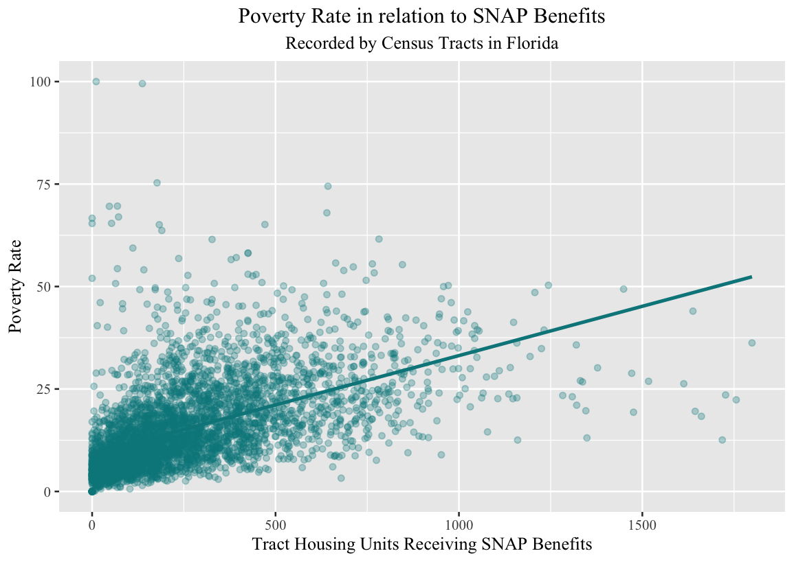
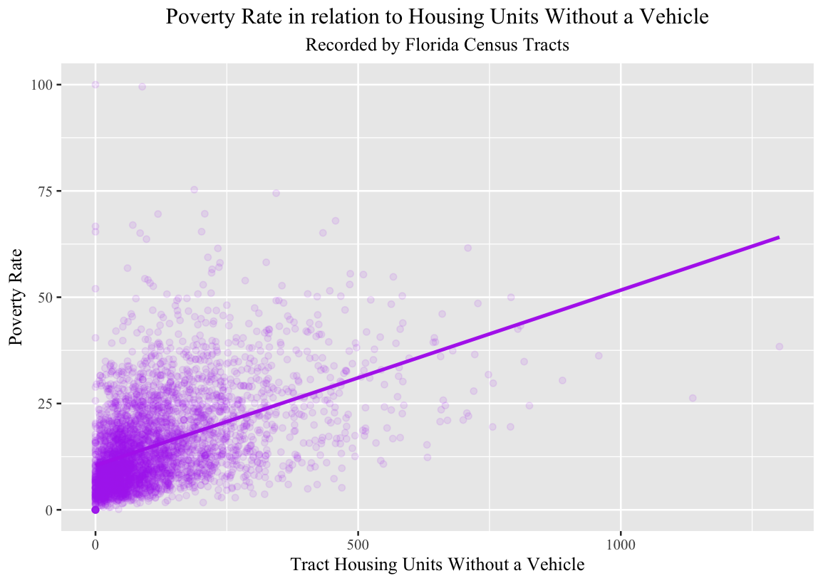
Findings From Data Analysis

Slide 5
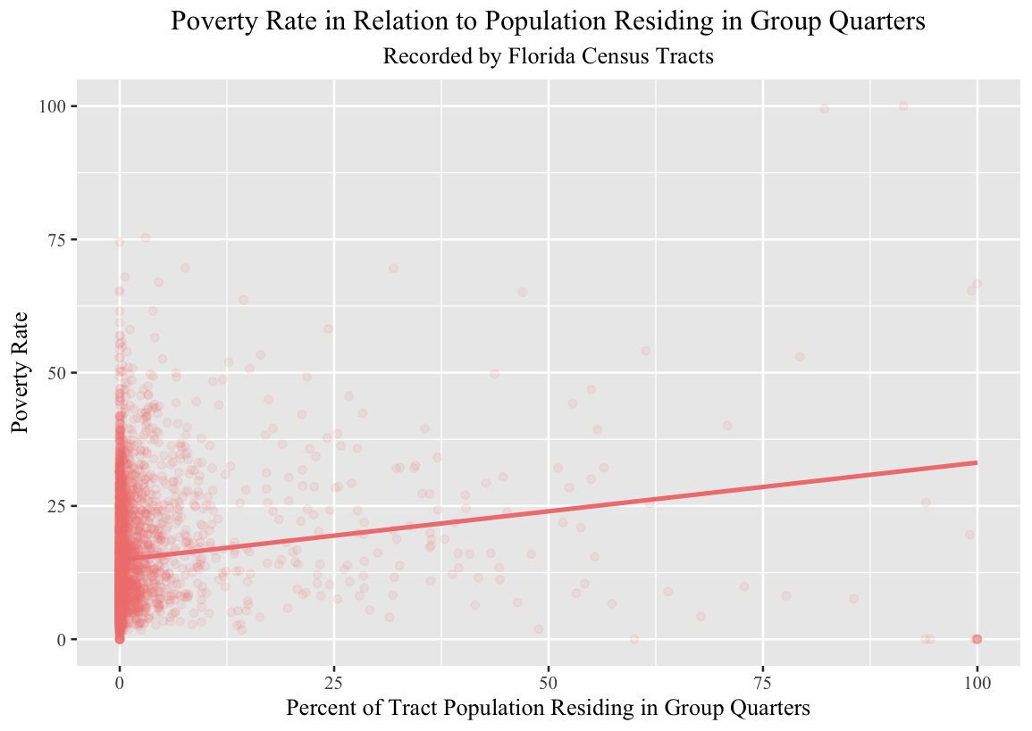
Findings From Data Analysis

Slide 6
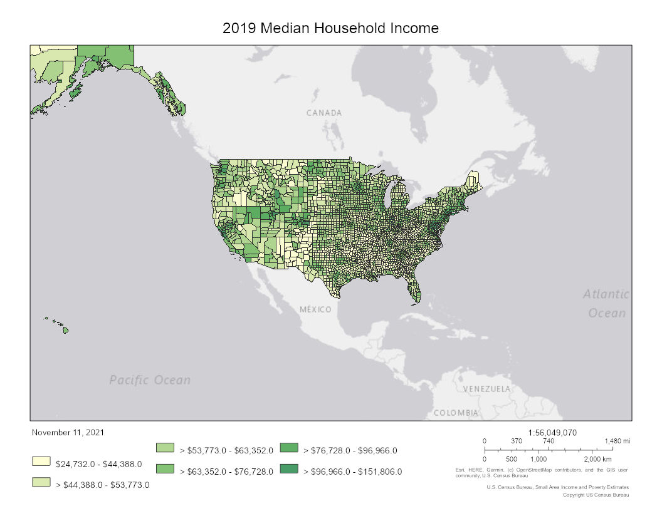
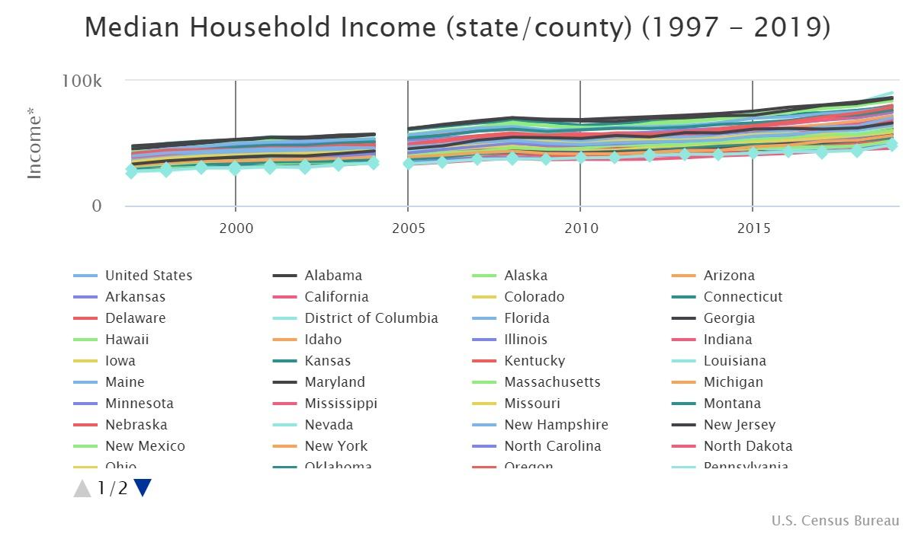
Small Area Income and Poverty Estimates (SAIPE)

Slide 7
Continued Efforts
Geocoding with Tidygeocoder
library(dplyr)
library(tidygeocoder)
dc_addresses <- tribble( ~name,~addr,
"White House", "1600 Pennsylvania Ave Washington, DC",
"National Academy of Sciences", "2101 Constitution Ave NW, Washington, DC 20418",
"Department of Justice", "950 Pennsylvania Ave NW, Washington, DC 20530",
"Supreme Court", "1 1st St NE, Washington, DC 20543",
"Washington Monument", "2 15th St NW, Washington, DC 20024")
coordinates <- dc_addresses %>%
geocode(addr)
Notes:
Project description given by Accenture FS.

Slide 8
Continued Efforts
Webscraping
Zillow
Walmart
Dollar Tree (Dollar General, etc.)
Winn-Dixie
Data Cleaning & Prep
Looking over NULL data points.
Joining datasets that can be relevant with each other.
Modeling
Considering techniques to implement such as linear regression and logistics regression.
Notes:
Project description given by Accenture FS.

Slide 9
Questions
All of our questions have been currently answered.
We are planning to send out a weekly reports over the break to showcase what we have been working on, as well as questions needed to progress in our modeling for Module 3.

Slide 10
Plan Over The Break
We are planning to web scrape and continue data preparation over the winter break.
Due to time constraints during the holidays, we will be emailing you our reports and questions weekly.
Notes:
Project description given by Accenture FS.

